Slide 1
Project 3
Group 3 - Algorithmic Trading with Python, Alpaca and AWS
Kalen Asberry
Connor Gross
Jonathan Park
Ivan Tatum

Slide 2
Summary and Motivation
The project seeks to deploy a simple trading bot using AWS cloud.
Amazon Web Services:
Persistent: AWS cloud services operate 24/7
Reliable: Reduces the risk of interruption due to internet outages, power outages, hardware failure, etc…
Affordable: Removes the need to setup our own server infrastructure

Slide 3
Initial Questions
What simple strategy can we use for our trading algorithm?
SMA Crossover
What trading platform has an API that we can connect our trading algorithm to?
Alpaca.markets
How do we deploy our trading algorithm on AWS?
EC2: Elastic Computing (EC2), is a Virtual machine where you can deploy secure, reliable and scalable websites, apps or process with free cloud computing in-memory caching according to AWS website.

Slide 4
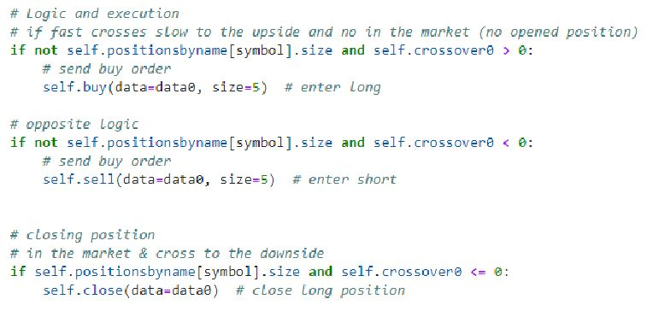
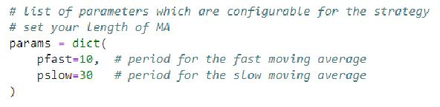
Trading Algorithm
Stock: The algorithm will trade the SPDR S&P 500 ETF (SPY)
Consistently high trading volume (liquidity)
Trading strategy: SMA Crossover
10 second short moving average
30 second long moving average
Crossover generates buy/sell signal

Slide 5
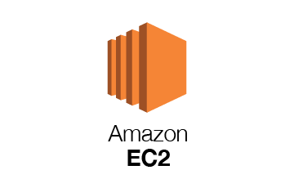
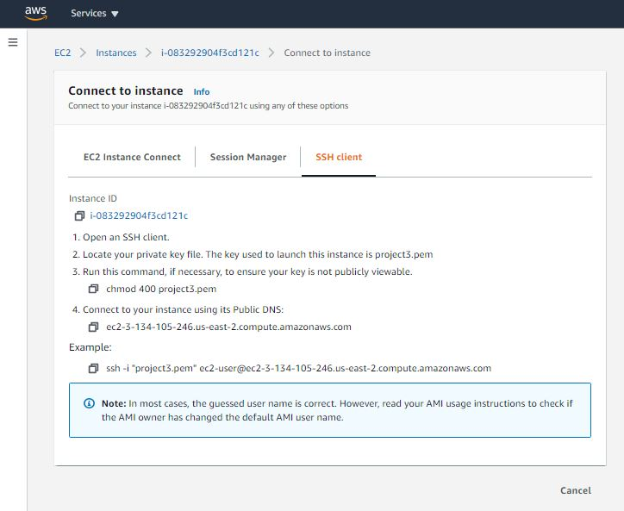
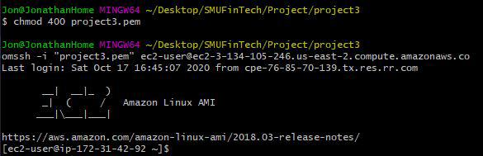
Connect To
Connect to the EC2 Instance

Slide 6
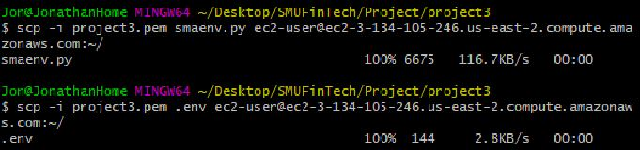
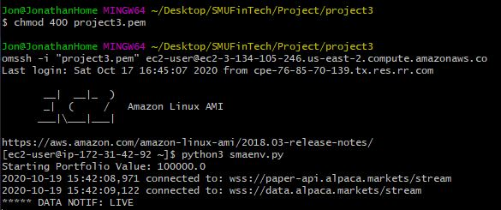
Upload Files And Run
Upload the trading algorithm (smaenv.py) and API keys (.env)
Execute the algorithm
Notes:
Chmod

Slide 7
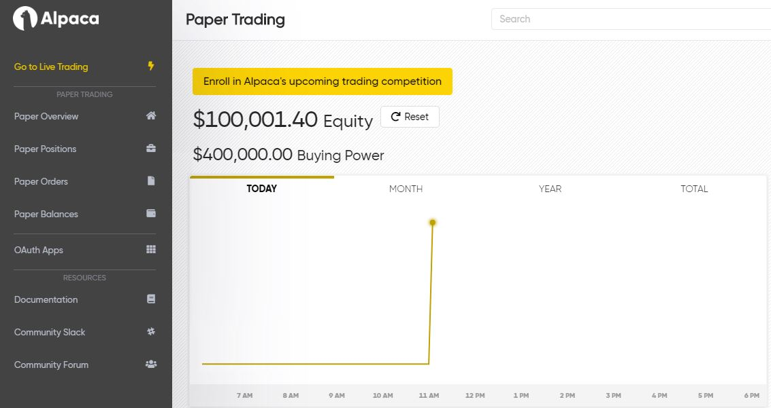
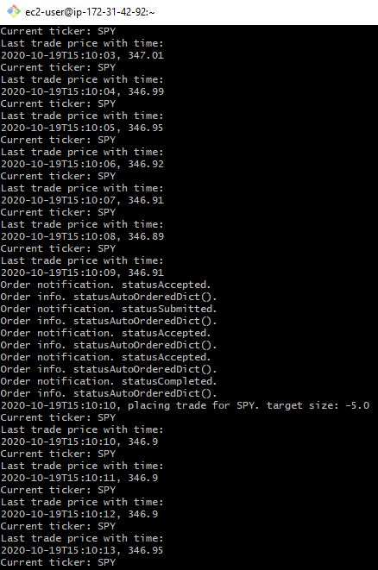
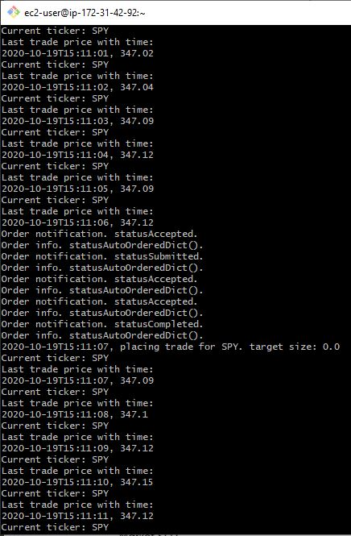
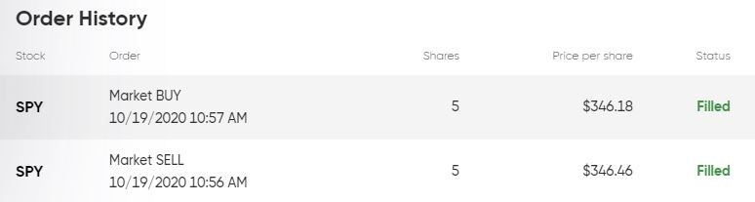
Trading Bot Activity

Slide 8
Discussion
To test the long-term effectiveness of any trading model, it has to be deployed in ‘real-time’ because past market behaviors are not indicative of future behaviors.
This model more or less served as a demo version for this project, as the main test and goal for the project was to automate the trading using Alpaca and AWS, not to code a trading algorithm.
To that end, connecting the code, AWS, and Alpaca proved far more challenging than initially anticipated.
A new instance has to be created on the Amazon EC2 virtual machine
Each Python package used must also be installed on the EC2 instance
Algorithm and other required files must be uploaded to the EC2 instance
It is relatively easy to connect the trading algorithm directly your local machine, but the downside is that it will not continuously or automatically run as it would if connected to EC2.

Slide 9
Cost
AWS EC2:
Free 750 hours per month of Linux, t2.micro or t3.micro instance
After 750 hours per month, AWS charges $1.59 per hour
Netflix spends $9.6 million per month on AWS EC2
Alpaca Margin Trading Rate
For accounts that have and use their margin capabilities, Alpaca charges 3.75% annually on the margin value in the account.

Slide 10
Continuing Work
Controlling the bot from AWS EC2
How do you turn the bot off once it has been deployed?
Can you stop the bot for a time and then restart it?
Is it possible to clone a virtual machine instance from EC2?
Further development of the trading algorithm
Visualization of moving average crossover and trading signals
Ability to switch between several different algorithms
Can the trading bot be deployed to Google Cloud or other cloud computing services?
Transition to live trading mode
How much starting balance is necessary to trade SPY?

